Slide 1




Weekly report: Storage System
11th week – 12th Presentation
Date: 09 /12/2025
Supervisor: Dr. Laurence Alhrshy
Group members: Mohamed Ahmed
09 /12/2025
Mohamed Ahmed
Storage System Team/ Optimus Syria
Notes:
`

Slide 2
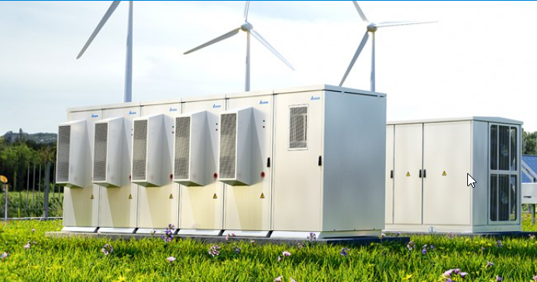
Content
Product specification
Cable Sizing
Equations Used in cable calculation
Converter Dimensioning (MA)
References
deltaww.com/en-US/index , 08/11/2025
09 /12/2025
2
Mohamed Ahmed
Storage System Team/ Optimus Syria

Slide 3
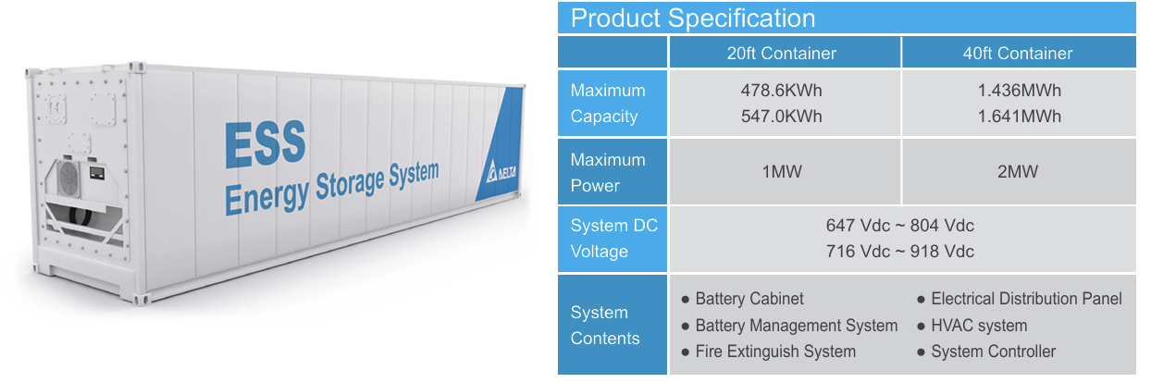
Product specification
Using two Delta 40 ft containers will be sufficient to accommodate the curtailed energy.
Each container provides a storage capacity of 1.641 MWh and a maximum power output of 2 MW, resulting in a total capacity of approximately 3.282 MWh
deltaww.com/en-US/products/Energy-Storage-Systems ,08/11/2025
09 /12/2025
3
Mohamed Ahmed
Storage System Team/ Optimus Syria

Slide 4
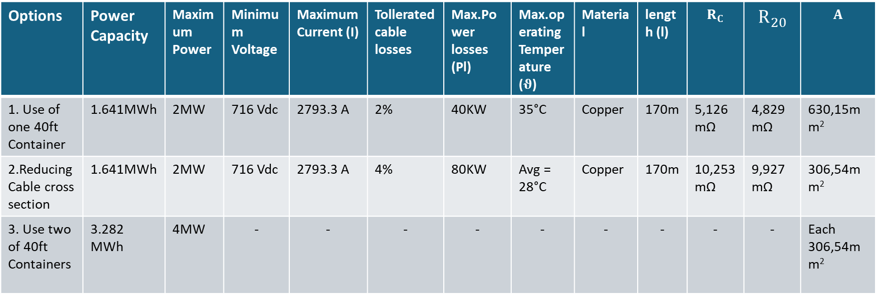
Cable Sizing
Options | Power Capacity | Maximum Power | Minimum Voltage | Maximum Current (I) | Tollerated cable losses | Max.Power losses (Pl) | Max.operating Temperature ($θ$) | Material | length (l) | $$R_{C}$$ | $$R_{20}$$ | $$A$$
1. Use of one 40ft Container | 1.641MWh | 2MW | 716 Vdc | 2793.3 A | 2% | 40KW | 35°C | Copper | 170m | 5,126mΩ | 4,829mΩ | 630,15mm²
2.Reducing Cable cross section | 1.641MWh | 2MW | 716 Vdc | 2793.3 A | 4% | 80KW | Avg = 28°C | Copper | 170m | 10,253mΩ | 9,927mΩ | 306,54mm²
3. Use two of 40ft Containers | 3.282 MWh | 4MW | - | - | - | - | - | - | - | - | - | Each 306,54mm²
09 /12/2025
4
Mohamed Ahmed
Storage System Team/ Optimus Syria

Slide 5

Equations Used: (from electrical lecture)
$R_{C}=\frac{P_{l}}{I^{2}}=R_{θ}$
$R_{θ}=R_{20}∗(1+a_{20}∗\left(θ−20°C\right))$
$R_{20}=\frac{R_{θ}}{(1+a_{20}∗\left(θ−20°C\right))}$
$R_{20}=ρ_{20,Cu}∗\frac{l}{A}$
$A= ρ_{20,Cu}∗\frac{l}{R_{20}}$
09 /12/2025
5
Mohamed Ahmed
Storage System Team/ Optimus Syria

Slide 6

Converter Dimensioning (MA)
Power Rating
  Rated WT power: 5 MW
  Maximum BESS power: 4 MW
  Converter must handle maximum system power = 5 MW
  Adding 10% safety margin:
  Converter Power Rating = 5 MW × 1.10 = 5.5 MW
Current Rating:
  DC-link voltage: 765.34 V
  Current calculated using:
  I= $\frac{P}{V} = \frac{\text{5,500,000}W}{\text{765.34 }V}$ = 7158𝐴
09 /12/2025
6
Mohamed Ahmed
Storage System Team/ Optimus Syria

Slide 7
Converter Dimensioning (MA)
Parameter | Value
Power Rating | 5.5 MW
Current Rating | 7185 A
DC Voltage | 765.34 V
Safety Margin | 10%
09 /12/2025
7
Mohamed Ahmed
Storage System Team/ Optimus Syria

Slide 8
References
https://www.deltaww.com/en-US/index
https://www.elkatek.com/en/
https://www.windfarmbop.com/medium-voltage-power-cables-in-wind-farms-an-introduction/
11 /11/2025
Mohamed Ahmed
Storage System Team/ Optimus Syria

